Slide 1
Solutions & Solubility
homogeneous mixtures
can be:
gas in gas
gas in liquid
solid in liquid
liquid in solid
solid in solid

Slide 2
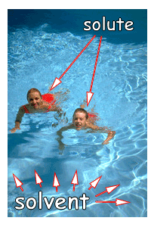
Solution Vocab.
solvent
largest quantity
most common solvent is water
solute
lesser quantity
saturated
sol^{n} can no longer dissolve solute
visible solute is present
solution is at EQUILIBRUM

Slide 3
For a system @ equilibrium:
RATE OF DISSOLVING = RATE OF SOLIDIFICATION
(precipitation)
(A saturated solution is in a type of dynamic equilibrium)
Every solution has a constant amount of solute that can be dissolved. This is temperature specific.

Slide 4
Soluble:
can dissolve to form a solution > 0.1M
aqueous
Low Soluble (insoluble; precipiate)
forms a saturated solution with a concentration < 0.1M
solid (liquid, gas)

Slide 5
Ionic Compounds:
made of ions
positive (1st) & negative ion
usually a metal (1st) & non metal
electrons are lost & gained
Molecular Compounds:
all non metals
share electrons

Slide 6
Solubility Trends
solubility changes with temperature
SOLIDS:
temperature increases, solubility increases
GASES:
temperature increases, solubility decreases

Slide 7
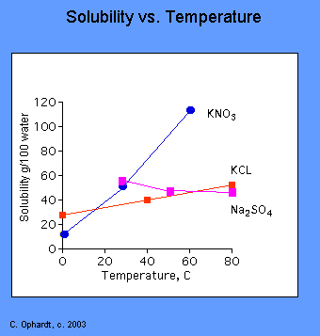
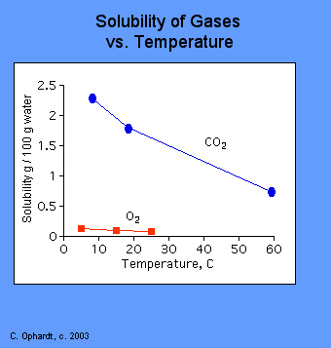

Slide 8
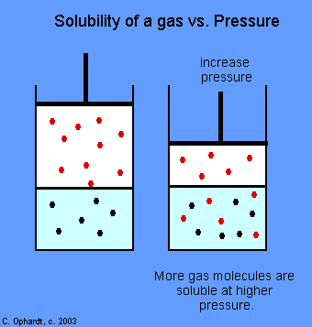
solubility changes with pressure
SOLIDS:
little affect
GASES:
increase pressure, increase solubility

Slide 9
Pulverizing & Stirring:
crushing the solute, increases the surface area
increases solubility
In general; LIKES DISSOLVE LIKE
polar dissolves polar
non polar dissolves non polar

Slide 10
Using Solubility Charts
Remember:
aqueous = dissolved = soluble
low solubility = not dissolved = ppt = solid
when 2 “aq” solutions are mixed a ppt can form
use the solubility chart to identify states

Slide 11
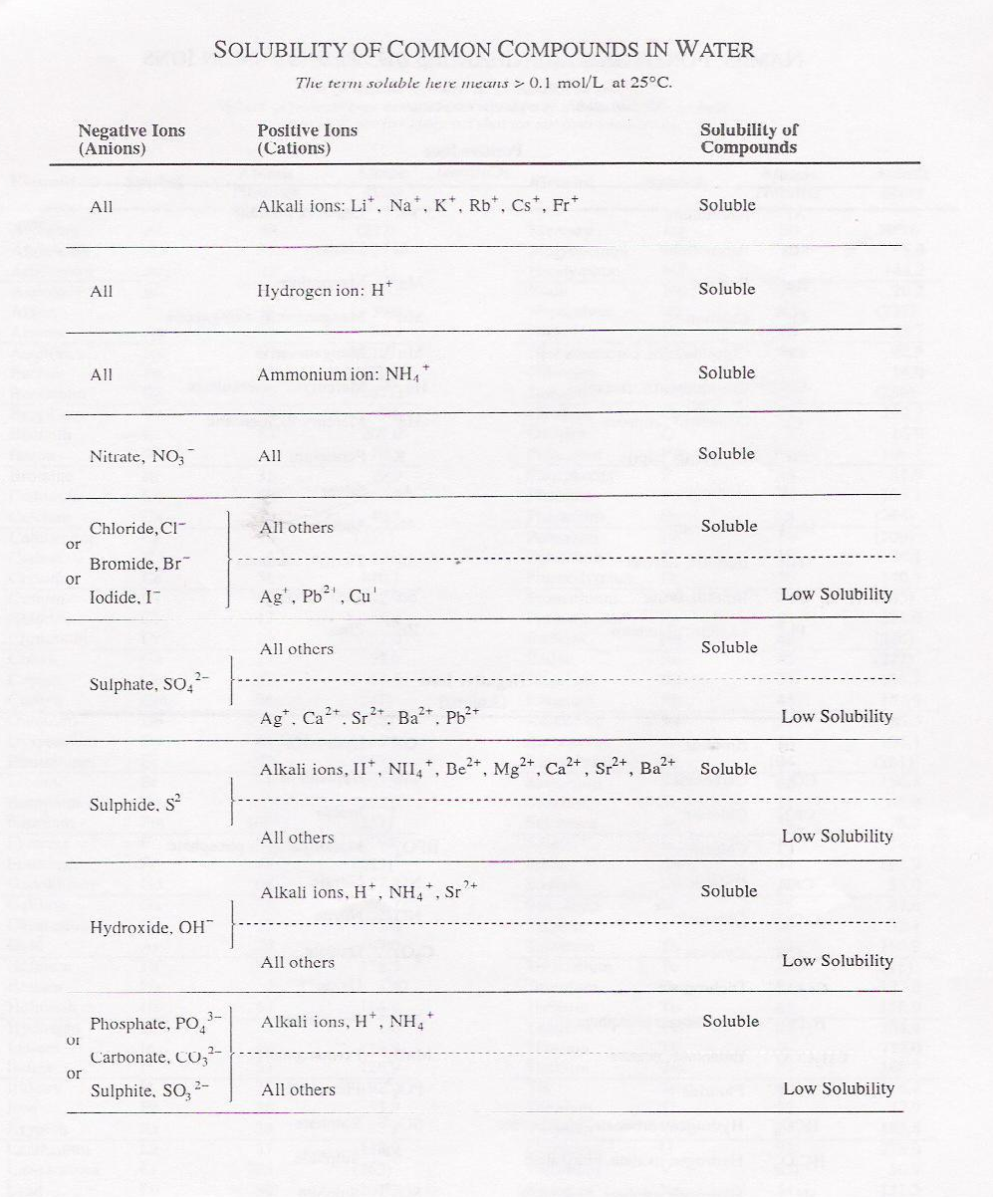

Slide 12
3 ways to express a rxn…
Molecular equation
complete formulas
CaCl_{2(aq)} + Na₂CO_{3(aq)} ←→ CaCO_{3(s)} + 2NaCl_{(aq)}
Full Ionic Equation
all “aq” compounds are broken into ions
Ca⁺²_{(aq)} + 2Cl⁻¹_{(aq)} + 2Na⁺_{(aq)} + CO₃⁻²_{(aq)} ←→ CaCO_{3(s)}
+ 2Na⁺_{(aq)} + 2Cl⁻¹_{(aq)}
Net Ionic Equation
all spectator ions cancelled
only chemicals involved in the rxn are written
Ca⁺²_{(aq)} + CO₃⁻²_{(aq)} ←→ CaCO_{3(s)}

Slide 13
Net Ionic Equation
can be written 2 ways.
DISSOLVING REACTION
solid reactant
products are ions
PRECIPITATION (CRYSTALLIZATION)REACTION
solid product
reactants are ions

Slide 14
Examples:
Write the dissolving rxn for FeCl_{3(s)}.
Write the crystallization rxn for (NH₄)₂Cr₂O_{7(s)}.
Write the rxn for CH₃OH_{(s)} dissolved in water

Slide 15
Using Solubility Charts – Qualitative Analysis
To predict chemical states.
solid or aqueous
To separate ions from solution.
To determine precipitate formation.
does a ppt form or not?
Identifying unknown ions in solution.

Slide 16
Separating Ions from Solution
Find a way to separate Ag⁺ from AgNO_{3(aq)}.

Slide 18
How do you separate Cl⁻¹ from NaCl_{(aq)}?

Slide 19
Remove all of the ions, one at a time, from
Sr(OH)_{2(aq)}.

Slide 21
Determining Rxn Outcomes
Predict the outcome between KNO₃ and NH₄Cl.
Predict the outcome of mixing NaCl and AgNO₃.
Predict the outcome of mixing LiOH with HCl.

Slide 22
Identifying Unknown Ions
Use the solubility chart to determine (narrow down) possible ions.
An unknown aqueous solution forms a precipitate when NaCl is added to the solution. What are the possible ions?

Slide 24
An unknown solution gives a precipitate when mixed with AgNO_{3(aq)}. What are the possible ions in solution? How would you further identify the ion?

Slide 26
A chemist carries out a series of precipitation reactions on an unknown solution and gets the following results:
NaNO₃ + unknown no ppt
NaS + unknown ppt
K₂SO₄ + unknown ppt
KCl + unknown ppt
What ion(s) could the unknown solution contain?

Slide 27
Ion Concentration – Quantitative Analysis
When a SOLUBLE chemical ionizes, the concentration of the ions can be determined if the initial concentration of the chemical is known.
Determine the ions concentration of:
3.0 M NaOH
1.5 M CaCl₂

Slide 28
Dilution of Solutions
M_{B}L_{B} = M_{A}L_{A}
Examples:
Calculate the concentration of each solution after mixing 10.0 mL of 0.100M Ba(NO₃)₂ and 40.0 mL of 0.300M AgNO₃.

Slide 29
If 5.0 mL of 0.020M Cl⁻¹ is added to 15.0 mL of 0.012M Br⁻¹, what is the molarity of the ions in the new mixture?

Slide 30
Quantitative Analysis
Remember:
a saturated solution is in equilibrium
even a low soluble compound dissolves a little bit (< 0.1M)
K = [P] (always!)
[R]

Slide 31
Consider CaCO₃:
CaCO_{3(s)} ←→ Ca⁺²_{(aq)} + CO₃⁻²_{(aq)}
K = [Ca⁺²][CO₃⁻²]
[CaCO₃]
*concentration of a solid is constant, therefore:
K[CaCO₃] = [Ca⁺²][CO₃⁻²]
or:
K_{sp}= [Ca⁺²][CO₃⁻²]

Slide 32
K_{sp} – Solubility Product Constant
ALL K_{sp} calculations must be done with DISSOLVING reactions
K_{sp} expressions NEVER have a denominator

Slide 33
Solubility Product - examples
The solubility of CaCO₃ is found to be
6.9 x 10⁻⁵M. What is the K_{sp} value for CaCO₃?

Slide 34
The molar solubility of Ag₂S is 1.3 x 10⁻¹⁷M. What is the K_{sp}?

Slide 35
A saturated solution of BaF₂ contains
3.58 x 10⁻³ mol of BaF₂ in a 1.00L solution. What is the K_{sp} for BaF₂?

Slide 36
If K_{sp} is known, molar solubility can be calculated.
K_{sp} does not have to be given
look K_{sp} up in the data table
page 5

Slide 37
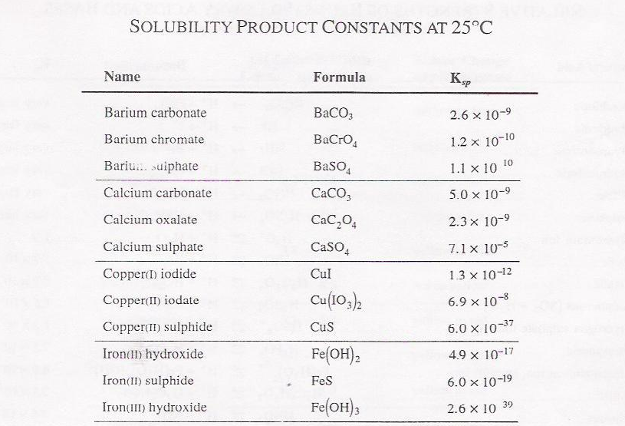

Slide 38
Precipitates can be formed in one of 2 ways:
One solid dissociates
ions come from a common source
use stoichiometry to get ion concentrations
A solid is formed from mixing 2 chemicals
ions come from 2 sources
use ions concentrations given in the question (don’t use stoich)

Slide 39
One Source - examples:
What is the ion concentration of each ion in a solution of copper (II) iodate?

Slide 40
What is the [Mg⁺²] in a saturated solution of Mg(OH)₂?

Slide 41
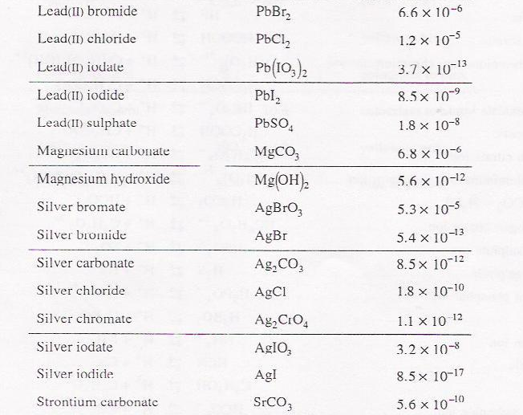

Slide 42
Two Sources - examples
A solution in equilibrium with BaF_{2(s)} has
4.50 x 10⁻²M Ba⁺² and 2.00 x 10⁻³M F⁻¹. What is the K_{sp}?

Slide 43
What mass of lead (II) iodide can be dissolved in 500.0 mL of water?

Slide 44
What mass of ZnS can be dissolved in 100.0 mL of water?

Slide 45
Trial Ion Product (TIP)
used to determine if a ppt will form when chemicals are mixed or not
calculate TIP using the values given in the problem (assume they are “eq” values)
compare TIP to actual Ksp (pg 5, data booklet)

Slide 46
Saturated solution
TIP = K_{sp}; no ppt
Unsaturated solution
TIP < K_{sp}; no ppt
Supersaturated solution
TIP > K_{sp};ppt will form (be present)

Slide 47
TIP examples
Will a PbCl₂ precipitate form in a 1.0L solution containing 0.015 mol of NaCl and 0.15 mol of Pb(NO₃)₂? K_{sp} PbCl₂ = 1.7 x 10⁻⁵

Slide 48
Will a ppt form when 5.0 mL of 6.0 x 10⁻⁵M Ag⁺ mixes with 10.0 mL of 4.2 x 10⁻⁶M Cl⁻¹? (hint: dilution calculation)

Slide 49
If 25.00 mL of 4.50 x 10⁻³M Pb(NO₃)₂ is mixed with 35.0 mL of 2.80 x 10⁻³M MgI₂, will a ppt form?

Slide 50
Determining Ion Concentration
K_{sp} values can be used to determine ion concentration.
concentration of a specific ion can be found
What is the maximum concentration of Ca⁺² ions which can exist in a 0.0060M solution of Na₂CO₃?

Slide 51
What [Cl⁻¹] is required to just start precipitating AgCl_{(s)} from a 3.6 x 10⁻³M solution of Ag⁺?

Slide 52
What concentration of strontium can be added to a 2.5 x 10⁻⁷M CaF₂ solution?

Slide 53
What concentration of S⁻² can be added to a solution of 8.2 x 10⁻²⁴M Fe₃P₂?

Slide 54
Titrations
can be used to determine the concentration of a specific ion.
A environmental chemist used 12.4 mL of 0.01M AgNO₃ to precipitate all the Br⁻¹ in a 125 mL sample. What is the concentration of Br⁻¹?

Slide 55
What volume of 0.125M AgNO₃ will be required to titrate 50.0 mL of 0.0550M Cl⁻¹ solution?

Slide 56
General Rules of Precipitation
In a mixture, the least soluble chemical will precipitate 1st.
smallest K_{sp} = 1st to ppt
small K_{sp} = more solid = less ions
Example: The molar solubility of:
AgCl = 1.3 x 10⁻⁵M
AgBr = 7.1 x 10⁻⁷M
when the [Ag⁺] = 7.1 x 10⁻⁷M, the AgBr_{(s)} will form
AgCl_{(s)} will not form until the [Ag⁺] = 1.3 x 10⁻⁵M

Slide 57
As the value of K_{sp} gets smaller (bigger negative exponent), the tendency to form a ppt increases
example:
K_{sp} of:
AgCl = 1.8 x 10⁻¹⁰
AgBr = 5.0 x 10⁻¹³
the lower K_{sp} means fewer ions are needed to form a ppt
therefore, AgBr will form a ppt 1st

Slide 58
Only TEMPERATURE changes K_{sp}
Just like K_{eq}

Slide 59
Common Ion Effect
Remember:
a saturated solution is @ equilibrium
ion product = K_{sp}
a system @ equilibrium follows Le Chatelier’s Principle
What is a COMMON ION?
compounds are mixed
the same ion comes from 2 different compounds in the mixture

Slide 60
Result of Common Ions…
causes the solubility of a solid to DECREASE in the mixture
WHY?
because a solution becomes saturated when the K_{sp} value is reached
since the solution already has some ions in it LESS IONS can be added before a ppt forms (compared to pure water)

Slide 61
Common Ion Example:
CaCO_{3(s)} ←→ Ca⁺²_{(aq)} + CO₃⁻²_{(aq)}
add CaCl_{2(aq)}
solution already contains Ca⁺²_{(aq)}
[Ca⁺²] increases
disrupts equilibrium
rxn shifts left
more CaCO_{3(s)} is produced (less soluble)

Slide 62
Common Ion Effect
the lowering of the solubility by adding a common ion

Slide 63
Uses of Common Ion
Remove ions from solution…
CaCO_{3(s)} ←→ Ca⁺²_{(aq)} + CO₃⁻²_{(aq)}
Ca⁺²_{(aq)} is one of the ions in hard water
add Na₂CO_{3(aq)}
CO₃⁻²_{(aq)} is a common ion
rxn shifts left
therefore, less Ca⁺²_{(aq)} in solution, water is less “hard”

Slide 64
Calculations with Common Ions
Use ICE BOX for calculations.
I = ion conc^{n} in the beaker BEFORE the 2nd
chemical is added
C = moles of solid that dissolve (often
unknown)
E = I + C

Slide 65
What is the molar solubility of PbI₂ in a 0.010M NaI solution?
K_{sp} for PbI₂ = 7.9 x 10⁻⁹
solid to be formed = PbI₂
solution contains NaI
NaI_{(aq)} ←→ Na⁺_{(aq)} + I⁻¹_{(aq)}
since [NaI] = 0.010M,
[I⁻¹] = 0.010M (stoich)
this is the “I” for [I⁻¹]

Slide 66
PbI_{2(s)} ←→ Pb⁺²_{(aq)} + 2I⁻¹_{(aq)}
I 0 0.010
C -x x 2x
E x 0.01 + 2x
= 0.01
Since K_{sp} is so SMALL, 0.01 + 2x = 0.01 (close enough)
K_{sp} = [Pb⁺²][I⁻¹]²
K_{sp} = (x)(0.01)² = 7.9 x 10⁻⁹
x = 7.9 x 10⁻⁹
(0.010)²
x = 7.9 x 10⁻⁵

Slide 67
[Pb⁺²] = 7.9 x 10⁻⁵
since [PbI₂] = [Pb⁺²]…. (stoich)
molar solubility of PbI₂ = 7.9 x 10⁻⁵
FYI:
in pure water, molar solubility of
PbI₂ = 1.3 x 10⁻³M (much greater than above)

Slide 68
What is the molar solubility of Fe(OH)_{3(s)} in a 0.0050 molar solution of NaOH?
K_{sp} = 1.6 x 10⁻³⁹

Slide 69
What is the molar solubility of AgI_{(s)} in a 0.0025 M solution of NaI?
K_{sp} = 8.5 x 10⁻¹⁷

Slide 70
A chemical is the MOST SOLUBLE in WATER!
LEAST SOLUBLE in a solution with a COMMON ION
solubility also depends on HOW MANY of each ion
Example:
NaI is least soluble in:
1.0 M H₂O
1.0 M LiI
1.0 M CaI₂
1.0 M Na₃PO₄

Slide 71
To Wrap Up…
Shifts in solubility
using common ions, the rxn shifts left
solubility decreases
REMOVE an ION from the sol^{n}, shifts right
solubility increases
to do this, add a chemical that will form a ppt with one of the ions in sol^{n}
example:
NaBr is added to a saturated solution of AgCl, what happens?
rxn is: AgCl_{(s)} ←→ Ag⁺_{(aq)} + Cl⁻¹_{(aq)}…

Slide 72
TEMPERATURE also affects solubility
SOLIDS
increase temp = increase solubility
therefore, behave as endothermic rxns
GASES
increase temp = decrease solubility
therefore, behave as exothermic rxns
TEMPERATURE changes K_{sp}
nothing else!

