Slide 1
Stoichiometry
Outcome 1: Mole Stoichiometry
Outcome 2: Mass Stoichiometry
Outcome 3: Gas Stoichiometry
Outcome 4: Percent Yield & Limiting Reactants

Slide 2
STOICHIOMETRY
a RATIO that compares the COEFFICIENTS of the BALANCED chemical reaction

Slide 3
Quantity of unknown chemical (mass)
Quantity of given chemical (mass)
CONVERT to MOLES
CONVERT
from MOLES
MOLES of given chemical
STOICHIOMETRY
MOLES of unknown chemical

Slide 4
2Fe_{(s)} + 3 H₂O_{(l)}→ Fe₂O_{3(s)} + 3H_{2(g)}
This means:
2 atoms of Fe will react with 3 molecules of H₂O
2 atoms of Fe will produce 1 molecule of Fe₂O₃
3 molecules of H₂ will also be produced
The coefficients can also represent MOLES!

Slide 5
2Fe_{(s)} + 3 H₂O_{(l)}→ Fe₂O_{3(s)} + 3H_{2(g)}
If a chemist use 4.00 mol of Fe_{(s)},
How much water is also needed?
How much hydrogen will be produced?

Slide 6
2Fe_{(s)} + 3 H₂O_{(l)}→ Fe₂O_{3(s)} + 3H_{2(g)}
How much iron (III) oxide will be made is 1.5 mol of H₂O_{(l)} is used?
How much iron must be used to make 0.10 mol of Fe₂O₃?

Slide 7
Stoichiometry Rules
Write out the reaction.
Balance the reaction.
Solve the problem using the coefficients and the unitary rate method.

Slide 8
Homework
Mole – Mole Problems Worksheet

Slide 9
Stoichiometry Drill
Sodium carbonate and hydrochloric acid react together to produce sodium chloride, carbon dioxide, and water.
Write a balanced chemical reaction.
If 25.0 mol of sodium chloride is needed, how many moles of sodium carbonate is needed?

Slide 10
You have 19.25 mol of hydrochloric acid, how many moles of water can be made?

Slide 11
Mass Stoichiometry
the coefficients DO NOT represent MASS
mass must be changed to MOLE before stoichiometry can be done
C_{(s)} + O_{2(g)}→ CO_{2(g)}
How much carbon dioxide can be made using 24 grams of carbon?

Slide 12
2 H₂O₂ → 2H₂O + O₂
If you start with 32.0 g of H₂O₂, how many moles of oxygen can you make?
What mass of water will be produced if 75.0 g of oxygen is produced?

Slide 13
2Fe + 3CuCl₂→ 2FeCl₃ + 3Cu
What mass of copper could be produced if you began with 65.2g of copper (II) chloride?
How much iron (III) chloride can be made from 3.00 moles of iron?

Slide 14
Homework
Mole – Mass Problems worksheet

Slide 15
Mass Stoichiometry Drill
NaCl_{(aq)} + AgNO_{3(aq)}→ NaNO_{3(aq)} + AgCl_{(s)}
How many moles of NaCl must be used to make 63.0g of sodium nitrate?
How much silver nitrate must be used to make 63.0g of sodium nitrate?

Slide 16
If there is 158.25g of silver nitrate, how much silver chloride can be made?

Slide 17
More Stoichiometry
The coefficients can represent:
MOLES
MOLECULES
VOLUME (if the reagents are gases)
Since this is true, we can use:
MOLES
MOLECULES
VOLUME
in the stoichiometry brackets.

Slide 18
Gas Stoichiometry
Use the following balanced equation:
4NH_{3(g)}+ 5O_{2(g)}→ 6H₂O_{(g)} + 4NO_{(g)}
How many litres of water vapour can be produced from 112L of ammonia gas at STP?

Slide 19
4NH_{3(g)}+ 5O_{2(g)}→ 6H₂O_{(g)} + 4NO_{(g)}
How many litres of oxygen are required to react with 8.96L of NH₃ at STP?
Calculate the volume of NH₃ that would be required to produce 134L of water at STP?

Slide 20
4NH_{3(g)}+ 5O_{2(g)}→ 6H₂O_{(g)} + 4NO_{(g)}
How many grams of NO can be produced from 224L of oxygen at STP?

Slide 21
Molecule Stoichiometry
Use the following balanced equation:
4NH_{3(g)}+ 5O_{2(g)}→ 6H₂O_{(g)} + 4NO_{(g)}
How many molecules of O_{2(g)} are needed to produce 1.20 x 10²⁴ molecules of NO?

Slide 22
4NH_{3(g)}+ 5O_{2(g)}→ 6H₂O_{(g)} + 4NO_{(g)}
How many molecules of water vapour can be produced from 34.1g of ammonia gas?
Which produces a larger volume of NO; 6.02 x 10²⁴ molecules of ammonia or 360.g of oxygen at STP?

Slide 24
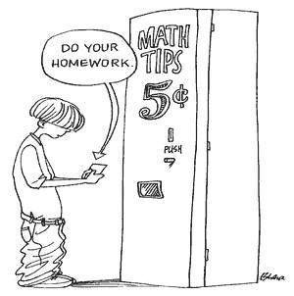
Homework
Particles, Mass, Volume, Molarity& Energy Problems

Slide 25
Stoichiometry& Energy
The amount of ENERGY in a balanced reaction is also present in the STOICHIOMETRIC RATIO
it can be treated as either a product or a reactant
the amount of energy required/produced will vary depending on the moles of chemical used

Slide 26
2H₂O₂ + 1102kJ → 2H₂O + O₂
How much energy do you need to make 640.g of oxygen?
How much water, in grams, can be made with 500.0 kJ of energy?

Slide 27
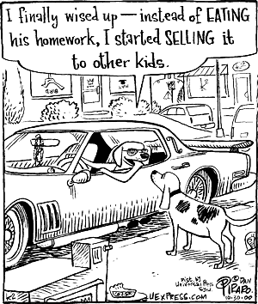
Homework
Particles, Mass, Volume, Molarity& Energy Problems

Slide 28
Gas, Mlcl, & Energy Drill
H_{2(g)} + Cl_{2(g)}→HCl_{(aq)} + 267 kJ
How many molecules of HCl can be made from 1.0g of hydrogen gas?

Slide 29
If 3.05L of chlorine gas is used:
How many litres of hydrochloric acid is made?
How much energy is required?

Slide 30
Molar Stoichiometry
Remember:
Molar refers to:
molarity (concentration)
solutions (aq)
To do molar stoichiometry:
combine stoichiometry&molarity calculation (M= mol/L)

Slide 31
2Al_{(s)} + 6HCl_{(aq)}→ 2AlCl_{3(aq)} + 3H_{2(g)}
How many moles of hydrogen can be made from 3.0L of 1.5M hydrochloric acid?
To solve:
1st – find mol HCl
2nd - stoich

Slide 33
2Al_{(s)} + 6HCl_{(aq)}→ 2AlCl_{3(aq)} + 3H_{2(g)}
What volume of 2.5M hydrochloric acid is required to make 8.50 mol of aluminum chloride?
To solve:
1st – stoich
2nd – find “L”

Slide 34
Calculate the concentration of potassium chloride if 45.7 mL will react with 25.0 mL of 0.40M silver nitrate in a double replacement reaction.
To solve:
Write balanced rxn
Take “inventory”
Find mol of AgNO₃
Stoich
Find M KCl

Slide 36
What is the volume of 2.5 M HCl required to react with 75.0 mL of 3.5M sodium hydroxide?

Slide 37
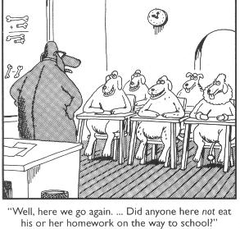
Homework
Particles, mass, Volume, Molarity& Energy Problems #6

Slide 38
Stoichiometry Drill
4CH₃NO_{2(l)} + 3O_{2(g)}→ 4CO_{2(g)} + 6 H₂O_{(l)}+ 2N_{2(g)}
What is the mass of water made when 0.150g of CH₃NO₂?
What volume of oxygen gas at STP is required to make 0.250 g of carbon dioxide?

Slide 39
What volume of 0.250M hydrochloric acid is required to neutralize 25.0 mL of 0.318M sodium hydroxide?

Slide 40
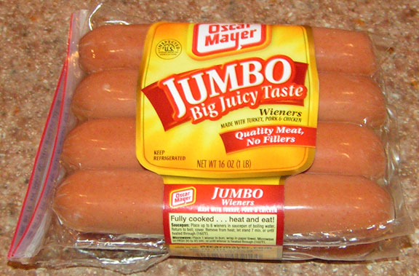
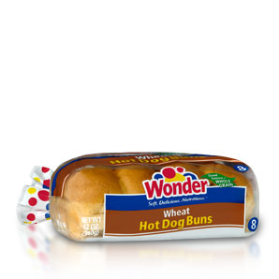
Limiting Reactants/Excess
4 wieners
8 buns…
How many hot dogs?

Slide 41
Another analogy…

Slide 42
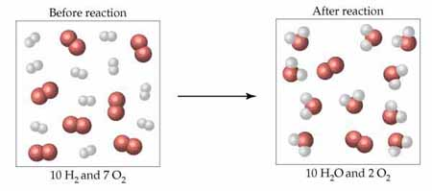
Limiting Reactant/Excess
Commonly, one chemical will RUN OUT (LIMITS) and the other will REMAIN (EXCESS) after the reaction stops

Slide 43
Definitions
EXCESS CHEMICAL
the chemical that is left over at the end of the reaction
LIMITING CHEMICAL
the chemical that runs out in the reaction
causes the reaction to STOP

Slide 44
To solve…
You must determine which chemical LIMITS the reaction
the limiting chemical will be entirely used, therefore,
use the LIMITING chemical for ALL CALCULATIONS

Slide 45
Examples
Consider the reaction:
2H₂O_{(l)} + O_{2(g)}→ 2H₂O_{2(l)}
If 4.00 mol of water was combined with 4.00
mol of oxygen, which reactant is in excess
and by how many moles?
To solve:
write the balanced rxn
compare the MOLES of each reactant
use LIMITING value for calculations

Slide 47
How much aluminum chloride can be made if 20.0g of aluminum reacts with 30.0g of chlorine?

Slide 49
A reaction starts with 45.0g of chlorine and 10.0g of sodium.
Which chemical is in excess?
How many moles of the excess chemical are left over?
How many grams of sodium chloride will be made?

Slide 51
Consider the reaction:
2H₂O_{(l)} + O_{2(g)}→ 2H₂O_{2(l)}
1.50 mol of water is combined with 1.20x10²⁴ molecules of oxygen. Which reactant limits the reaction?

Slide 53
How much hydrogen peroxide will be made in the previous reaction?

Slide 54
HCl + NaOH→NaCl + HOH
If 1.5 mL of 2.00 M HCl is combined with 1.25 mL of 2.25M NaOH, which chemical is in excess and by how much?

Slide 56
Homework
Excess Problem Worksheet

Slide 57
Excess Problems Drill
Cu(OH)₂ + Na₃PO₄→NaOH + Cu₃(PO₄)₂
Balance the reaction.
If 6.00 mol of each reactant is used, which reactant is in excess? By how much?
If 5.00g of Cu(OH)₂ and 2.50g of Na₃PO₄ are used, how much NaOH will be produced?

Slide 59
Yield Calculations
ACTUAL YIELD
the amount produced in a reaction
measured during the lab OR:
given in the question
rarely 100% (due to errors)
THEORETICAL YIELD
the amount that COULD be produced if there were NO errors in the lab
CALCULATE using stoichiometry

Slide 60
Percent Yield
Percentage Yield = actual yieldx 100%
theoretical yield
Or:
% = ax 100%
t
units do not matter as long as they are the SAME!

Slide 61
Let’s Practice
If 12.5g of copper reacts with an excess of chlorine, 25.4g of copper (II) chloride is produced. Calculate the theoretical yield and percent yield for the reaction.

Slide 62
If 6.57g of iron is reacted with an excess of hydrochloric acid, hydrogen gas and 14.63g of iron (III) chloride are produced. Calculate the theoretical and percent yield of this reaction.

Slide 63
300.0 mL of 0.500M silver nitrate reacts with an excess of copper to make 14.75g of silver. (Copper ions are 2+) What is the percent yield of silver?

Slide 64
Aluminum reacts in a single replacement reaction with copper (II) chloride. If 8.50g of aluminum and 125.0 mL of 1.50M CuCl₂ are mixed, what is the theoretical yield of copper? The percent yield of this reaction is 75.0%, what mass of copper is actually produced?

Slide 66
Homework
Percent Yield Worksheet

